Slide 1
Nursing Home Market
unsupervised learning and text analytic
Team 15: Jingjing Lu, Tiam Moradi, Tsung Yen Wu, Scott McCoy

Slide 2
CONTENTS
01
Part One
Business Problem

Slide 3
As a consulting company...
Clients
Clustering
Scraping
Potential Customers
Marketing Services to nursing homes
Developing targeted marketing strategies for distinctive groups
Identifying nursing homes whose online reviews do not match actual performance

Slide 4
CONTENTS
02
Part Two
Dataset:
Description and EDA

Slide 5
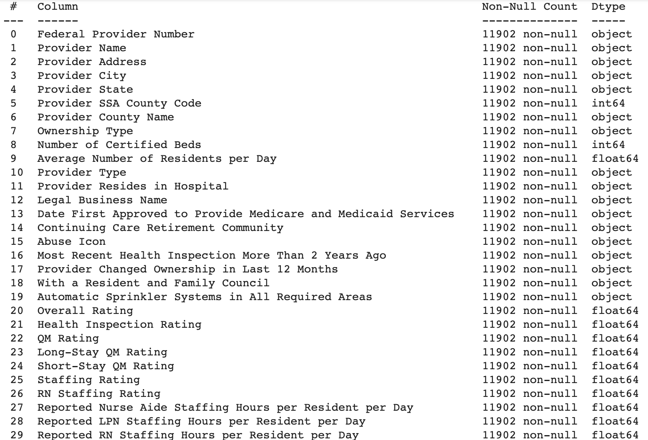
Dataset Description
Dataset
Features
Centers for Medicare and Medicaid Services (CMS) Nursing Home Inspection data: Provider Information
87 Columns:
Provider Information
Ratings Calculated by CMS
General Statistics
Notes:
Our primary dataset is the Centers for Medicare and Medicaid Services (CMS) Nursing Home Inspection data.
Even just this one table contains a massive amount of information with 87 columns containing a variety of numeric and categorical data. A brief description of the types of columns is listed below: Provider info, Ratings from CMS, and general Statistics
The original data set has 87 columns and 15,331 rows. After we took out some columns that are not useful. For example, the zip code, phone number, and footnotes. We are left with 75 columns. After we drop the null value, we got 75 columns with 11,902 rows.

Slide 6
Exploratory Data Analysis
Provider State
TX | 1210
CA | 1187
OH | 952
IL | 711
FL | 704
Top 5 States with most nursing homes

Slide 7
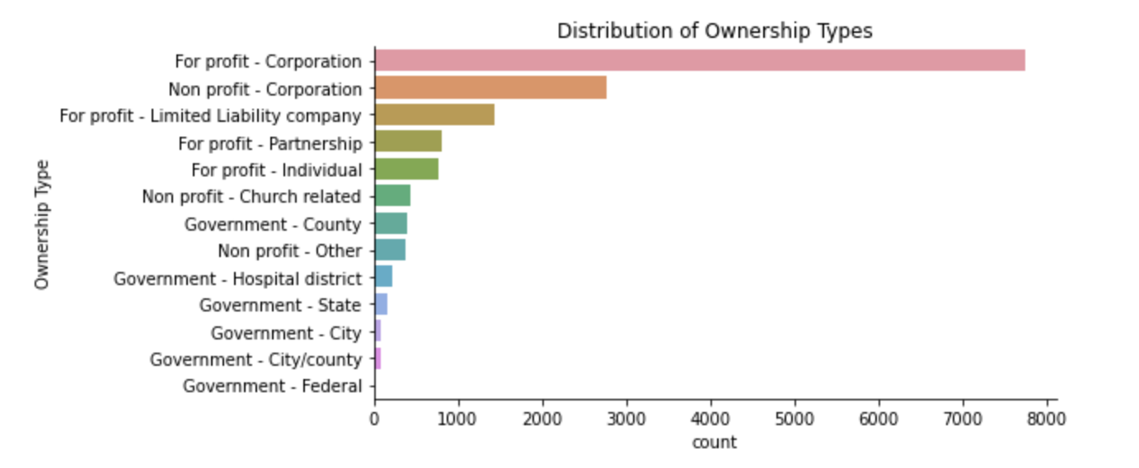
Exploratory Data Analysis
Distribution of ownership types
Notes:
Surprisingly, top 2 ownership types are from corporation and government ownership are least

Slide 8
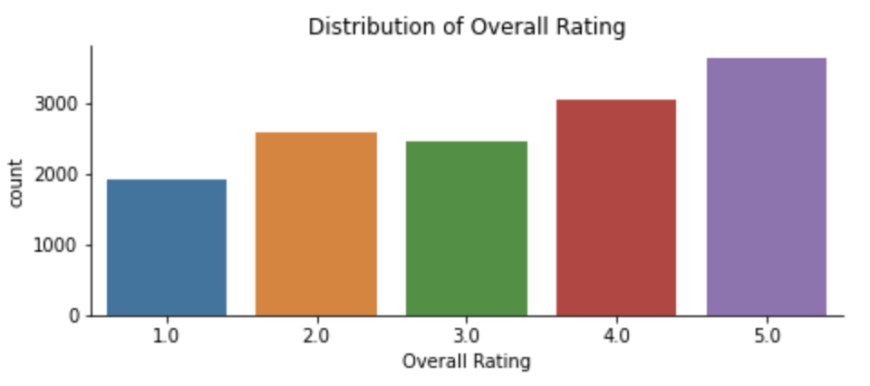
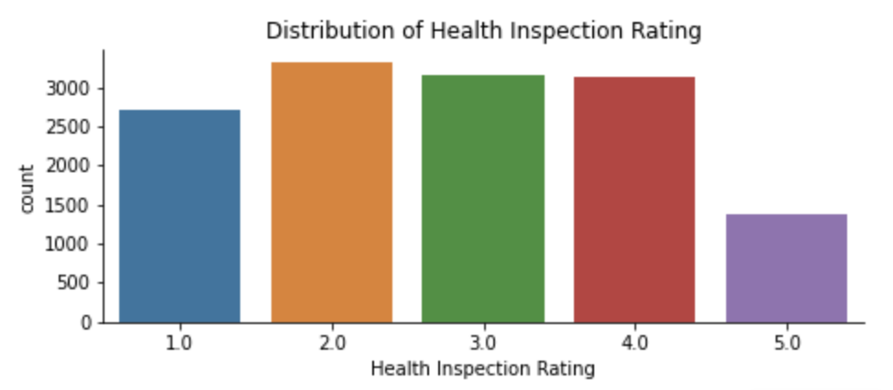
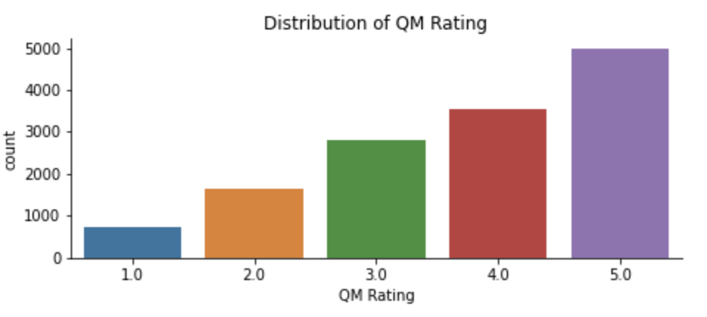
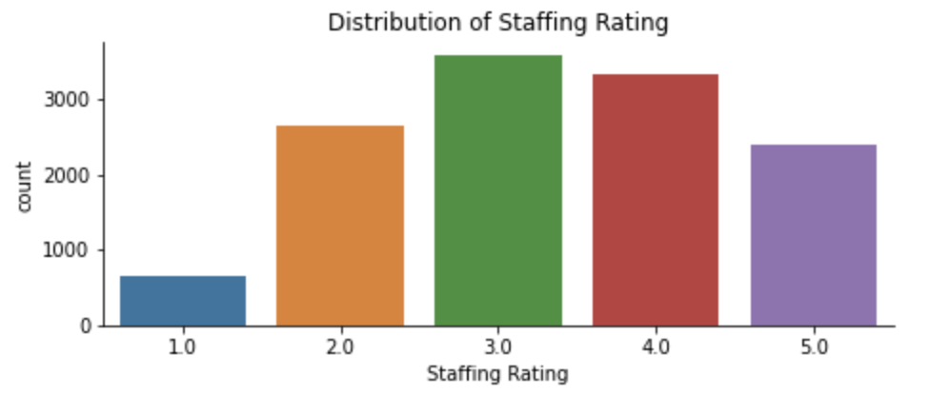
Exploratory Data Analysis
Notes:
Overall rating is Based on the star ratings for the health inspection domain, the staffing domain and the quality measure domain
Ratings for the health inspections domain are based on the number, scope, and severity of deficiencies identified during the three most recent annual inspection surveys, as well as substantiated findings from the most recent 36 months of complaint investigations and focused infection control surveys. The health inspections rating also takes into account the number of revisits required to ensure that deficiencies identified during health inspection surveys have been corrected.
As you can see, It is harder to get rating 5 compare to other measures
quality measure are based on performance on a subset of 10 MDS-based QMs and five measures that are created using Medicare claims. These measures were selected for use in the rating system based on their validity and reliability
Ratings for the staffing domain are based Registered nurse (RN) hours per resident per day and total nurse(licensed practical nurse (LPN), and nurse aide) hours per resident per day
Not many nurses are working overtime

Slide 9
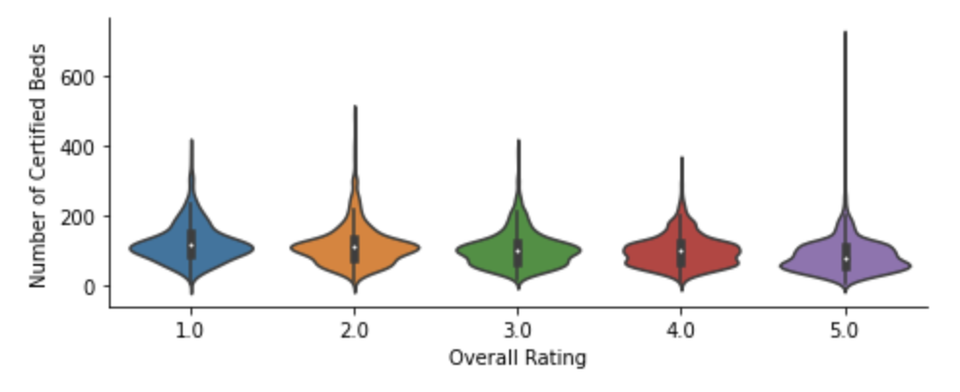
Exploratory Data Analysis
Number of certified beds vs. Overall rating
Is there any relationship between overall rating and number of beds?

Slide 10
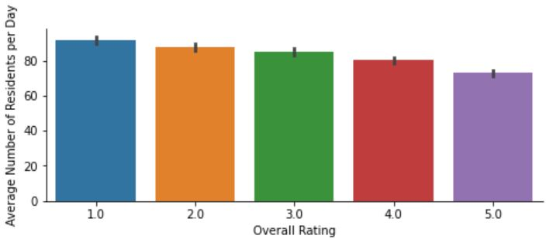
Exploratory Data Analysis
Avg. number of residents per day
In general, the better rating comes with less average number of residents per day

Slide 11
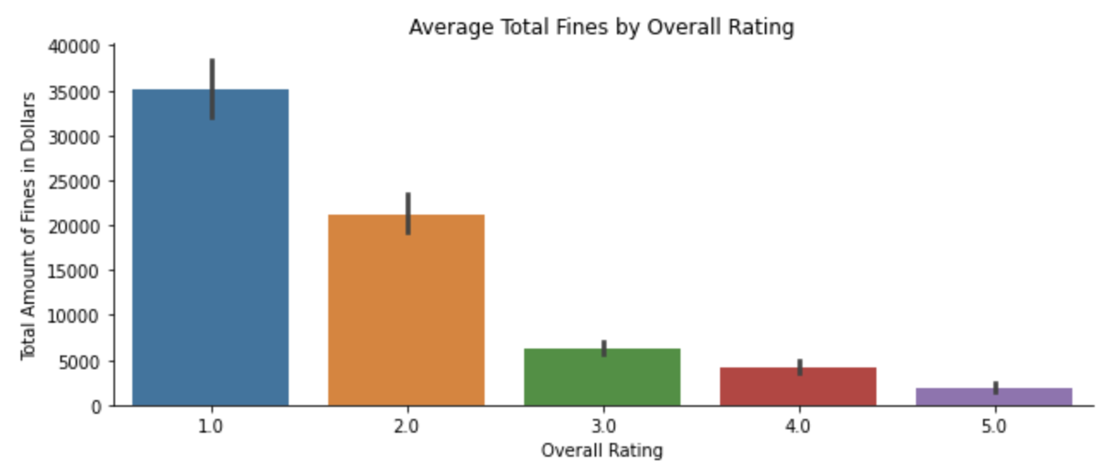
Exploratory Data Analysis
Avg. total fine vs. Overall rating
Notes:
After some basic understanding of our data, Scott will show our finding through clusterings.

Slide 12
CONTENTS
03
Part Three
Clustering:
Customer Segmentation

Slide 13
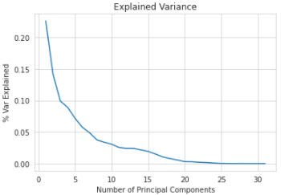
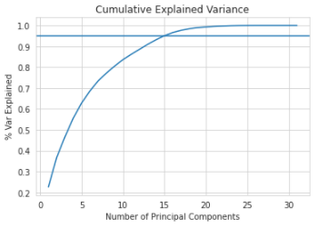
Dimension Reduction with PCA

Slide 14
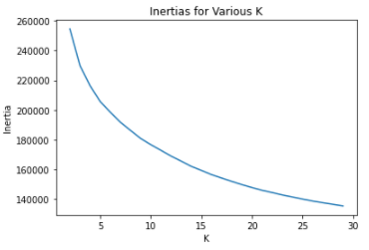
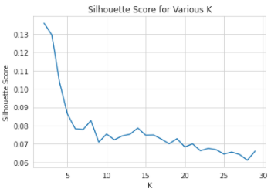
Clustering
K-Means Model Selection
Evaluate Inertia and Silhouette Scores for various K
Settle on K = 6
Notes:
Could need more with kmeans and the reasons why choosing 6

Slide 15
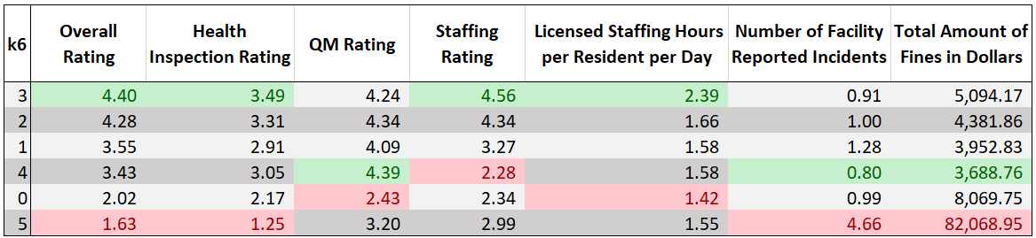
Cluster Evaluation
Cluster Profiles
Table shows mean values for a few key features for each cluster
Can use these to profile customer segments and tailor marketing strategies
Notes:
Interpretation needed, maybe bullet points

Slide 16
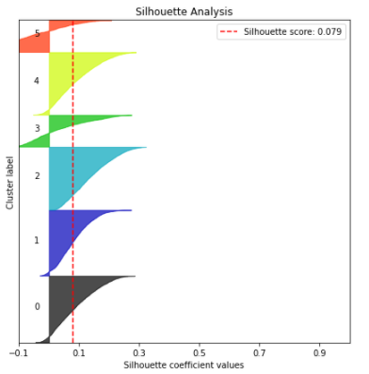
Cluster Evaluation
Silhouette Plot
Notes:
Left if more space needed

Slide 17
CONTENTS
04
Part Four
Review Mining

Slide 18

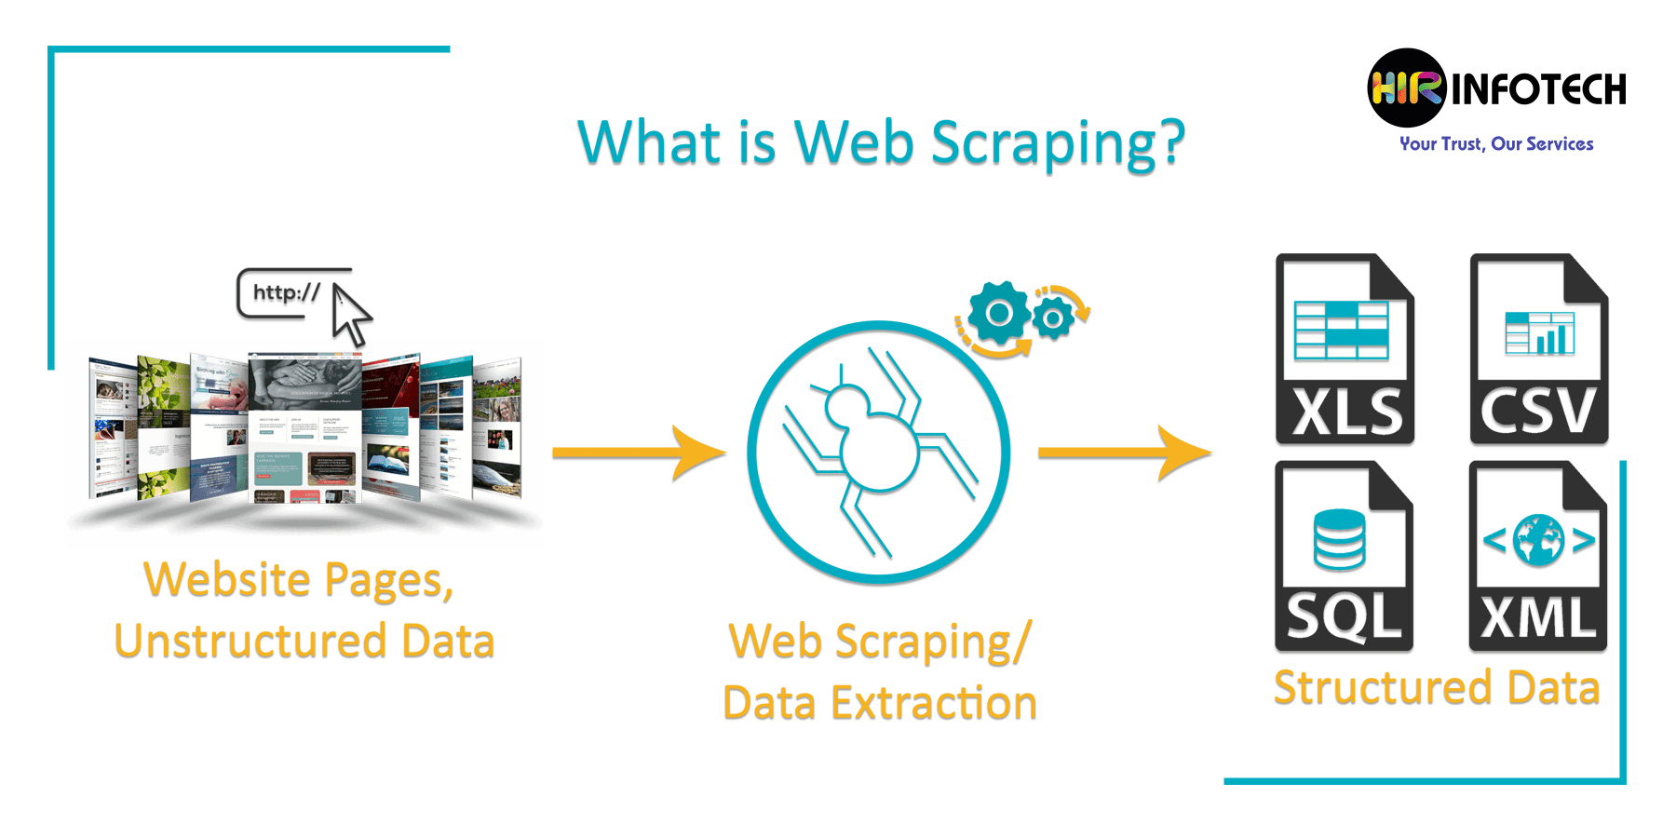
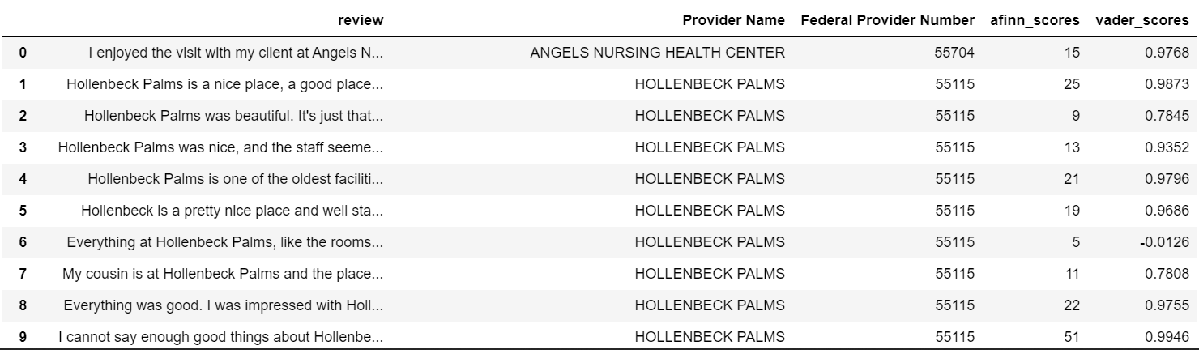
Review Mining: Scraping Nursing Home Reviews
Notes:
Left if more space needed

Slide 19
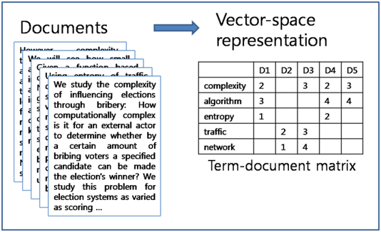

Review Mining: Results and Reflection
Issues
Future work
Notes:
Hol Hollenback Palms and Broadway Manor Care
Issues:
Dictionary based approach: may need to customize to include unique words
Nursing homes with less reviews may be with a disadvantage
We can use document term matrices / supervised
learning methods to classify / use ngrams.
Increase number of views by using a crawling spider
Utilize
Use different websites

Slide 20
CONTENTS
05
Part Five
Conclusions/
Recommendations

Slide 21



Conclusions/Recommendations
Clustering
text analytics
Next Step
Marketing strategies tailored for each group
how their sentiment scores compared with their overall rating as calculated by CMS
Gather larger number of online reviews

Slide 22
THANKS

